Slide 1

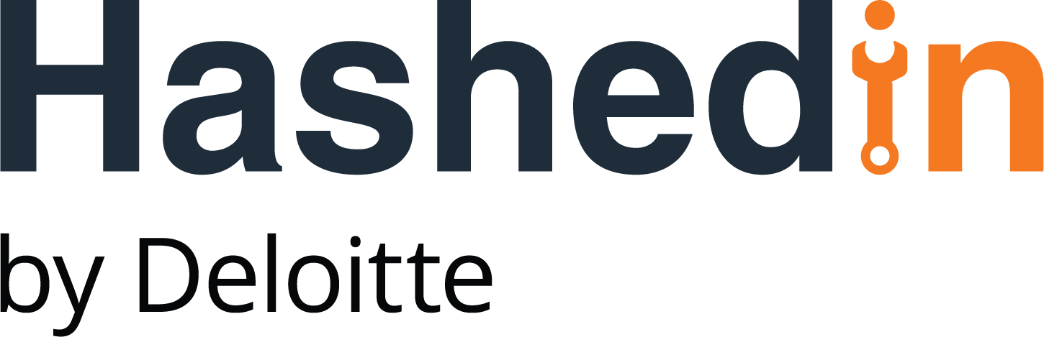

The Relay
Final Idea Presentation:
ReAd360

Slide 2
ReAD360 – Using ML models to predict readmission for Diabatic patient
PROBLEM STATEMENT:
Patients diagnosed with Diabetes Mellitus have a much higher readmission rate (14.4–22.7%)​. Unplanned readmission leads to:
For Hospitals: Over utilization of resources, increase in operational costs, penalties*, poor staff planning and
For Insurance companies: Increase in expense (around $12500 for 4 to 5 days of stay)
Solution: A predictive model to identify readmission risk of hospitalized patients with diabetes by analyzing EHRs
Source of Idea: Relay Brainstorming
Sector / Sub-sector: Healthcare
Target Clients: HCA Healthcare, Universal Health services,
United Health Insurance (not exhaustive)
MVP Demo Script
Front end User Interface: To take input data of new patients (EHRs), analyze, and provide intelligent analysis to classify if the patient has higher chances of readmission.
AI Module: The algorithm will analyze trends and patterns in the EHRs. This will help in identifying and flagging critical patients with a high probability of readmission.
RISKS / CHALLENGES
Risk – Data for model training
Mitigation – Using data from Kaggle and requesting access to latest relevant data from our US partners
Risk – Understanding medical terminologies
Mitigation – Consulting medical SMEs to understand the data set better
*charged by Centre of Medicare and Medicaid services (CMS) for exceeding number of readmissions for a certain disease in a hospital, if readmitted within 30 days (Affordable care Act (2012), Hospital Readmission Reduction program)
Notes:
Heart failure is highly prevalent (25 % in chronic heart failure and up to 40 % in acute heart failure) in patients with diabetes mellitus. Its prevalence is four-times higher than that of the general population
People with diabetes are about 3 times more likely to die with flu and pneumonia.
Diabetes is both a marker for high-risk, resource-intensive, and expensive care after CABG and an independent risk factor for reduced long-term survival
The Hospital Readmissions Reductions Program (HRRP), created as part of the Affordable Care Act, punishes general acute-care hospitals when more Medicare patients return for a new admission within 30 days of discharge than the government standardized rate.
The Centre for Medicare and Medicaid service (CMS) include these 6 conditions for penalties:
Acute myocardial infarction (AMI)
Chronic Obstructive Pulmonary Disease (COPD)
heart failure
Pneumonia
Coronary Artery Bypass Graft (CABG) Surgery
Hip or knee replacement

Slide 3
Proposed Tech Stack
GCP Services | Tasks\Utilities
Cloud API Gateway | API Management & Exposure
Cloud Run | Deployment/Run Services
Cloud Storage | Storage for Historical Data & ML Models, static web hosting
Cloud SQL with PostgreSQL RDS | Transactional Data – Track, update & use as history later
SendGrid | Notification for async process,
Cloud CDN | Web Application distribution
Cloud Pub/Sub | Async data exchange between services/applications
CATEGORY | Language\Framework
Front End | ReactJS
Back End (Services) | Python 3.x (Flask)
Database | PostgreSQL v14
Cloud Solution | GCP
Version Control | Git
Category | Resources Required | Resources Available
Machine Learning | 4 | 3
Front End | 1 | 1
Backend | 2 | 2
QA | 1 | 2
DevOps | 1 | 0
Technical Features | Feasibility
Analyze Historical Data to create ML Models automatically | Feasible
Calculate Patient Readmission Score based on new patient input | Feasible
Synchronous & Asynchronous nature | Feasible

Slide 4
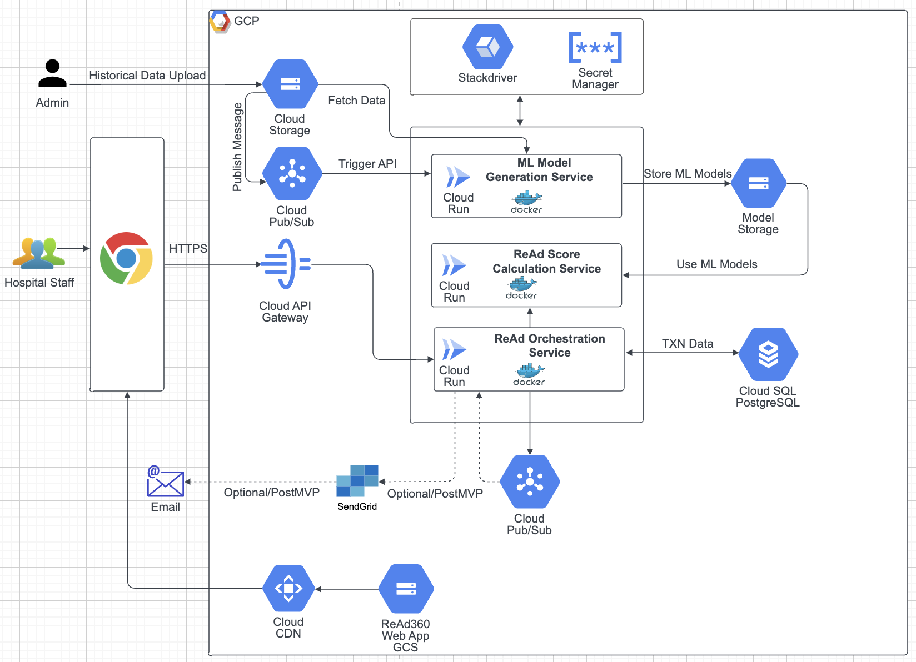
Technical Architecture

Slide 5
Deloitte refers to one or more of Deloitte Touche Tohmatsu Limited (“DTTL”), its global network of member firms, and their related entities (collectively, the “Deloitte organization”). DTTL (also referred to as “Deloitte Global”) and each of its member firms and related entities are legally separate and independent entities, which cannot obligate or bind each other in respect of third parties. DTTL and each DTTL member firm and related entity is liable only for its own acts and omissions, and not those of each other. DTTL does not provide services to clients. Please see www.deloitte.com/about to learn more.
© 2021. For information, contact Deloitte Touche Tohmatsu Limited.

